Slide 1
Angular Architecture

Slide 2
Angular Architecture
The goal of Angular is simple: bring HTML and JavaScript together in a manageable and scalable way in order to build a client application.
To do that, Angular uses a component-based approach with supporting entities, such as services and directives being injected into the components at runtime.
This approach may seem a bit odd at first, but it allows us to keep a clear separation of concerns and generally maintain a clearer project structure.

Slide 3
Angular Architecture (continued)
In order to understand the basics of Angular, take a look at the following figure:

Slide 4

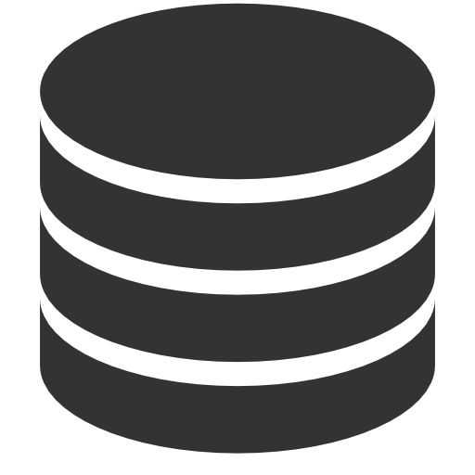
Understanding Round-Trip and Single-Page Applications
For a long time, web apps were developed to follow a round-trip model.
The browser requests an initial HTML document from the server.
User interactions—such as clicking a link or submitting a form—led the browser to request and receive a completely new HTML document.
request
client
server
response

Slide 5
Understanding Round-Trip and Single-Page Applications (continued)
In this kind of application, the browser is essentially a rendering engine for HTML content, and all of the application logic and data resides on the server.
The browser makes a series of stateless HTTP requests that the server handles by generating HTML documents dynamically.
A lot of current web development is still for round-trip applications, not least because they require little from the browser, which ensures the widest possible client support.

Slide 6
Understanding Round-Trip and Single-Page Applications (continued)
But there are some disadvantages to roundtrip applications:
they make the user wait while the next HTML document is requested and loaded
they require a large server-side infrastructure to process all the requests and manage all the application state
they require more bandwidth because each HTML document has to be self-contained (leading to a lot of the same content being included in each response from the server).

Slide 7
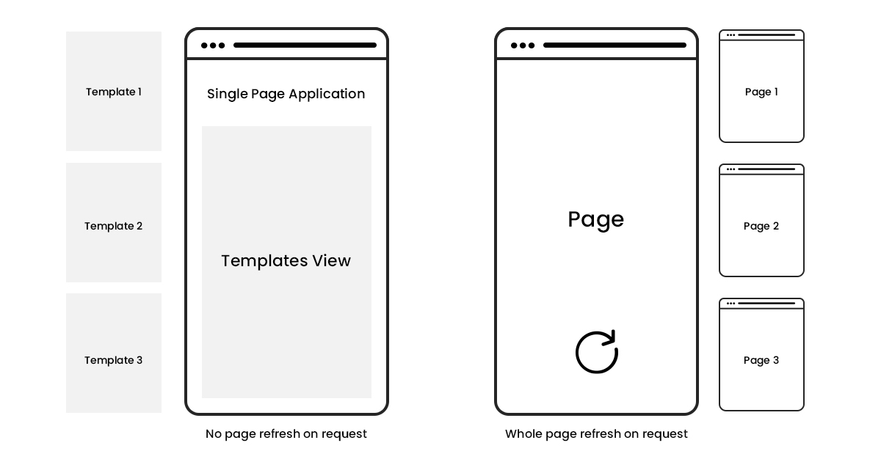
Understanding Round-Trip and Single-Page Applications (continued)
Single-page applications take a different approach.
An initial HTML document is sent to the browser, but user interactions lead to Ajax requests for small fragments of HTML or data inserted into the existing set of elements being displayed to the user.
The initial HTML document is never reloaded or replaced, and the user can continue to interact with the existing HTML while the Ajax requests are being performed asynchronously, even if that just means seeing a “data loading” message.

Slide 8
Understanding Round-Trip and Single-Page Applications (continued)
Angular excels in single-page applications and especially in complex round-trip applications.
The single-page application model is perfect for Angular, not just because of the initialization process but because the benefits of using the MVC pattern really start to manifest themselves in larger and more complex projects.
Note: Another phrase you may encounter is progressive web applications (PWAs).
Progressive applications continue to work even when disconnected from the network and have access to features such as push notifications.

Slide 9
Comparing Angular to React and Vue.js
There are two main competitors to Angular: React and Vue.js.
There are some low-level differences between them, but, for the most part, all of these frameworks are excellent, all of them work in similar ways, and all of them can be used to create rich and fluid client-side applications.
The main difference between these frameworks is the developer experience.
Angular requires you to use TypeScript to be effective, for example. If you are used to using a language like C# or Java, then TypeScript will be familiar and avoids dealing with some of the oddities of the JavaScript language.
Vue.js and React are less opinionated and don’t require TypeScript (although it is supported by both frameworks) but lean toward mixing HTML, JavaScript, and CSS content together in a single file.

Slide 10
The MVC Pattern revisited
The key to applying the MVC pattern is to implement the key premise of a separation of concerns, in which the data model in the application is decoupled from the business and presentation logic.
In client-side web development, this means separating the data, the logic that operates on that data, and the HTML elements used to display the data.
The result is a client-side application that is easier to develop, maintain, and test.

Slide 11
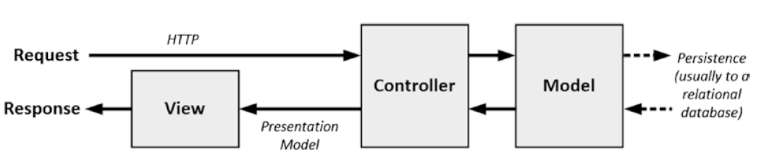
The MVC Pattern revisited (continued)
The three main building blocks are the model, the controller, and the view.
In the following figure, you can see the traditional exposition of the MVC pattern as it applies to server-side development.
You can see that the expectation is that the model is obtained from a database and that the goal of the application is to service HTTP requests from the browser – this is the basis for round-trip web apps.
The server-side implementation of the MVC pattern

Slide 12
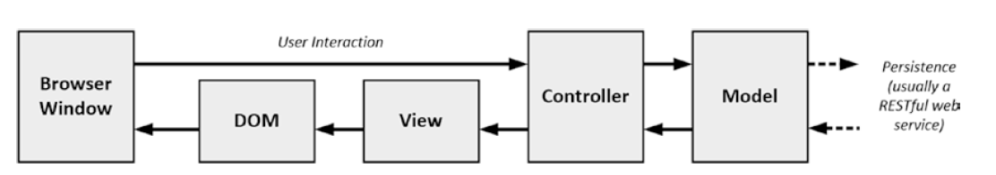
The MVC Pattern revisited (continued)
Of course, Angular exists in the browser, which leads to a twist on the MVC theme, as illustrated in the following figure:
The client-side implementation of the MVC pattern gets its data from server-side components, usually via a RESTful web service
The goal of the controller and the view is to operate on the data in the model to perform DOM manipulation so as to create and manage HTML elements that the user can interact with.
Those interactions are fed back to the controller, closing the loop to form an interactive application.
A client-side Implementation of the MVC pattern

Slide 13
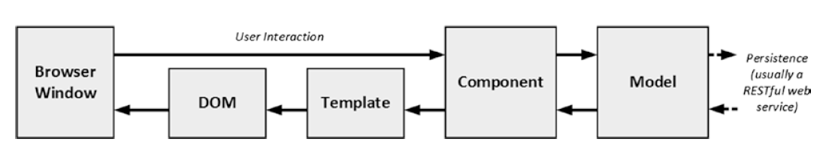
The MVC Pattern revisited (continued)
Angular uses slightly different terminology for its building blocks, which means that the MVC model implemented using Angular looks more like the following figure:
The Angular Implementation of the MVC pattern

Slide 14
Understanding Models
Models—the M in MVC—contain the data that users work with.
There are two broad types of model:
view models, which represent just data passed from the component to the template
domain models, which contain the data in a business domain, along with the operations, transformations, and rules for creating, storing, and manipulating that data, collectively referred to as the model logic.

Slide 15
Understanding Models (continued)
The model in an application built using the MVC pattern should:
Contain the domain data
Contain the logic for creating, managing, and modifying the domain data (even if that means executing remote logic via web services)
Provide a clean API that exposes the model data and operations on it
The model should not:
Expose details of how the model data is obtained or managed (in other words, details of the data storage mechanism or the remote web service should not be exposed to controllers and views)
Contain logic that transforms the model based on user interaction (because this is the component’s job)
Contain logic for displaying data to the user (this is the template’s job)

Slide 16
Understanding Controllers/Components
Controllers, which are known as components in Angular, are the connective tissue in an Angular web app; they act as conduits between the data model and views.
Components add business domain logic required to present aspects of the model and perform operations on it.

Slide 17
Understanding Controllers/Components (continued)
A component that follows the MVC pattern should:
Contain the logic required to set up the initial state of the template
Contain the logic/behaviours required by the template to present data from the model
Contain the logic/behaviours required to update the model based on user interaction
A component should not:
Contain logic that manipulates the DOM (that is the job of the template)
Contain logic that manages the persistence of data (that is the job of the model)

Slide 18
Understanding Views/Templates
Views, which are known as templates in Angular, are defined using HTML elements that are enhanced by data bindings.
It is the data bindings that make Angular so flexible, and they transform HTML elements into the foundation for dynamic web applications.

Slide 19
Understanding Views/Templates (continued)
Templates should:
Contain the logic and markup required to present data to the user
Templates should not
Contain complex logic (this is better placed in a component or one of the other Angular building blocks, such as directives, services, or pipes)
Contain logic that creates, stores, or manipulates the domain model
Templates can contain logic, but it should be simple and used sparingly.
Putting anything but the simplest method calls or expressions in a template makes the overall application harder to test and maintain.

Slide 20
Understanding RESTful Services
The logic for domain models in Angular apps is often split between the client and the server.
The server contains the persistent store, typically a database, and contains the logic for managing it.
You don’t want the client-side code accessing the data store directly—doing so would create a tight coupling between the client and the data store that would complicate unit testing and make it difficult to change the data store without also making changes to the client code.
By using the server to mediate access to the data store, you prevent tight coupling.
The logic on the client is responsible for getting the data to and from the server and is unaware of the details of how that data is stored or accessed behind the scenes.

Slide 21
Understanding RESTful Services (continued)
There are lots of ways of passing data between the client and the server.
One of the most common is to use Ajax requests to call server-side code, getting the server to send JSON and making changes to data using HTML forms.
This approach can work well and is the foundation of RESTful web services, which use the nature of HTTP requests to perform CRUD operations on data.

Slide 22
Understanding RESTful Services (continued)
In a RESTful web service, the operation that is being requested is expressed through a combination of the HTTP method and the URL.
So, for example, imagine a URL like this one:
http://myserver.mydomain.com/people/bob
There is no standard URL specification for a RESTful web service, but the idea is to make the URL self-explanatory, such that it is obvious what the URL refers to.
In this case, it is obvious that there is a collection of data objects called people and that the URL refers to the specific object within that collection whose identity is bob.

Slide 23
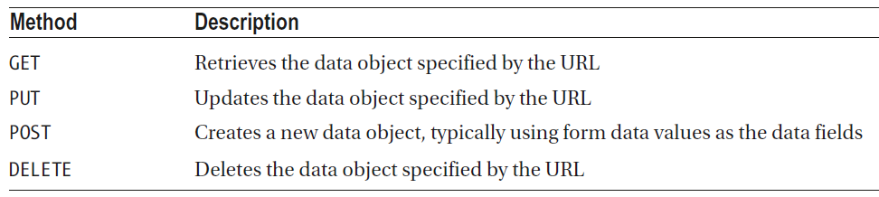
Understanding RESTful Services (continued)
The URL identifies the data object that we want to operate on, and the HTTP method specifies what operation we want to be performed, as described in the following table:
You don’t have to use the HTTP methods to perform the operations described in the table.
A common variation is that the POST method is often used to serve double duty and will update an object if one exists and create one if not, meaning that the PUT method isn’t normally used.

